Slide 1
Hosting Agreement Overview

Slide 2
Moving towards an informed decision
10+ years of review and public engagement:
Community Visioning and Guiding Principles
Municipally-driven studies on social, economic and community effects
Independent Peer Review of NWMO and Municipality’s studies including geologic studies, impacts on environment, infrastructure and community
Willingness engagement and decision to hold a public referendum
Hosting Agreement
Negotiations based on 36 Guiding Principles and studies findings

Slide 3
Mapping the Future
Hosting Agreement covers scenarios where South Bruce stays or exits the process
Referendum
NWMO Site Selection
Detailed design, federal processes
Willing
Selected
Not willing
Not selected

Slide 4
Willingness Outcome
Willing
South Bruce awaits site selection
Not Selected
South Bruce exits process
Selected
Hosting agreement for the
138-year duration of Project

Slide 5
Willingness Outcome
Not Willing
South Bruce exits process

Slide 6
Safety and the Environment
NWMO studied and has described how facility will operate safely and securely
Independent consultants reviewed and validated safety case on behalf of South Bruce
Only used Canadian fuel and small amounts of Project-related waste will be stored
Federal process for Impact Assessment and licensing by Canadian Nuclear Safety Commission will review site specific design
Study and Peer Review work continues

Slide 7
Municipal Voice
Licensing
Municipality will support NWMO in federal licensing and also reserves right to express concerns on local matters
Governance
Leadership Table with Mayor and NWMO CEO
Implementation Committee of Municipal and NWMO staff
Independent arbitration
Project Scope Modifications
At least three years of community engagement/education before NWMO applies to store new types of used Canadian nuclear fuel

Slide 8
Community Wellbeing
Infrastructure & Services
NWMO will pay for any Project-related costs for municipal infrastructure upgrades, roads, water and wastewater services and emergency services
These will only be determined after site selection
Additional Community Benefits
Community amenities at Centre of Expertise and potential recreational opportunities on the DGR lands
Joint training and Employment working groups
Property Value Protection and business loss protection programs

Slide 9
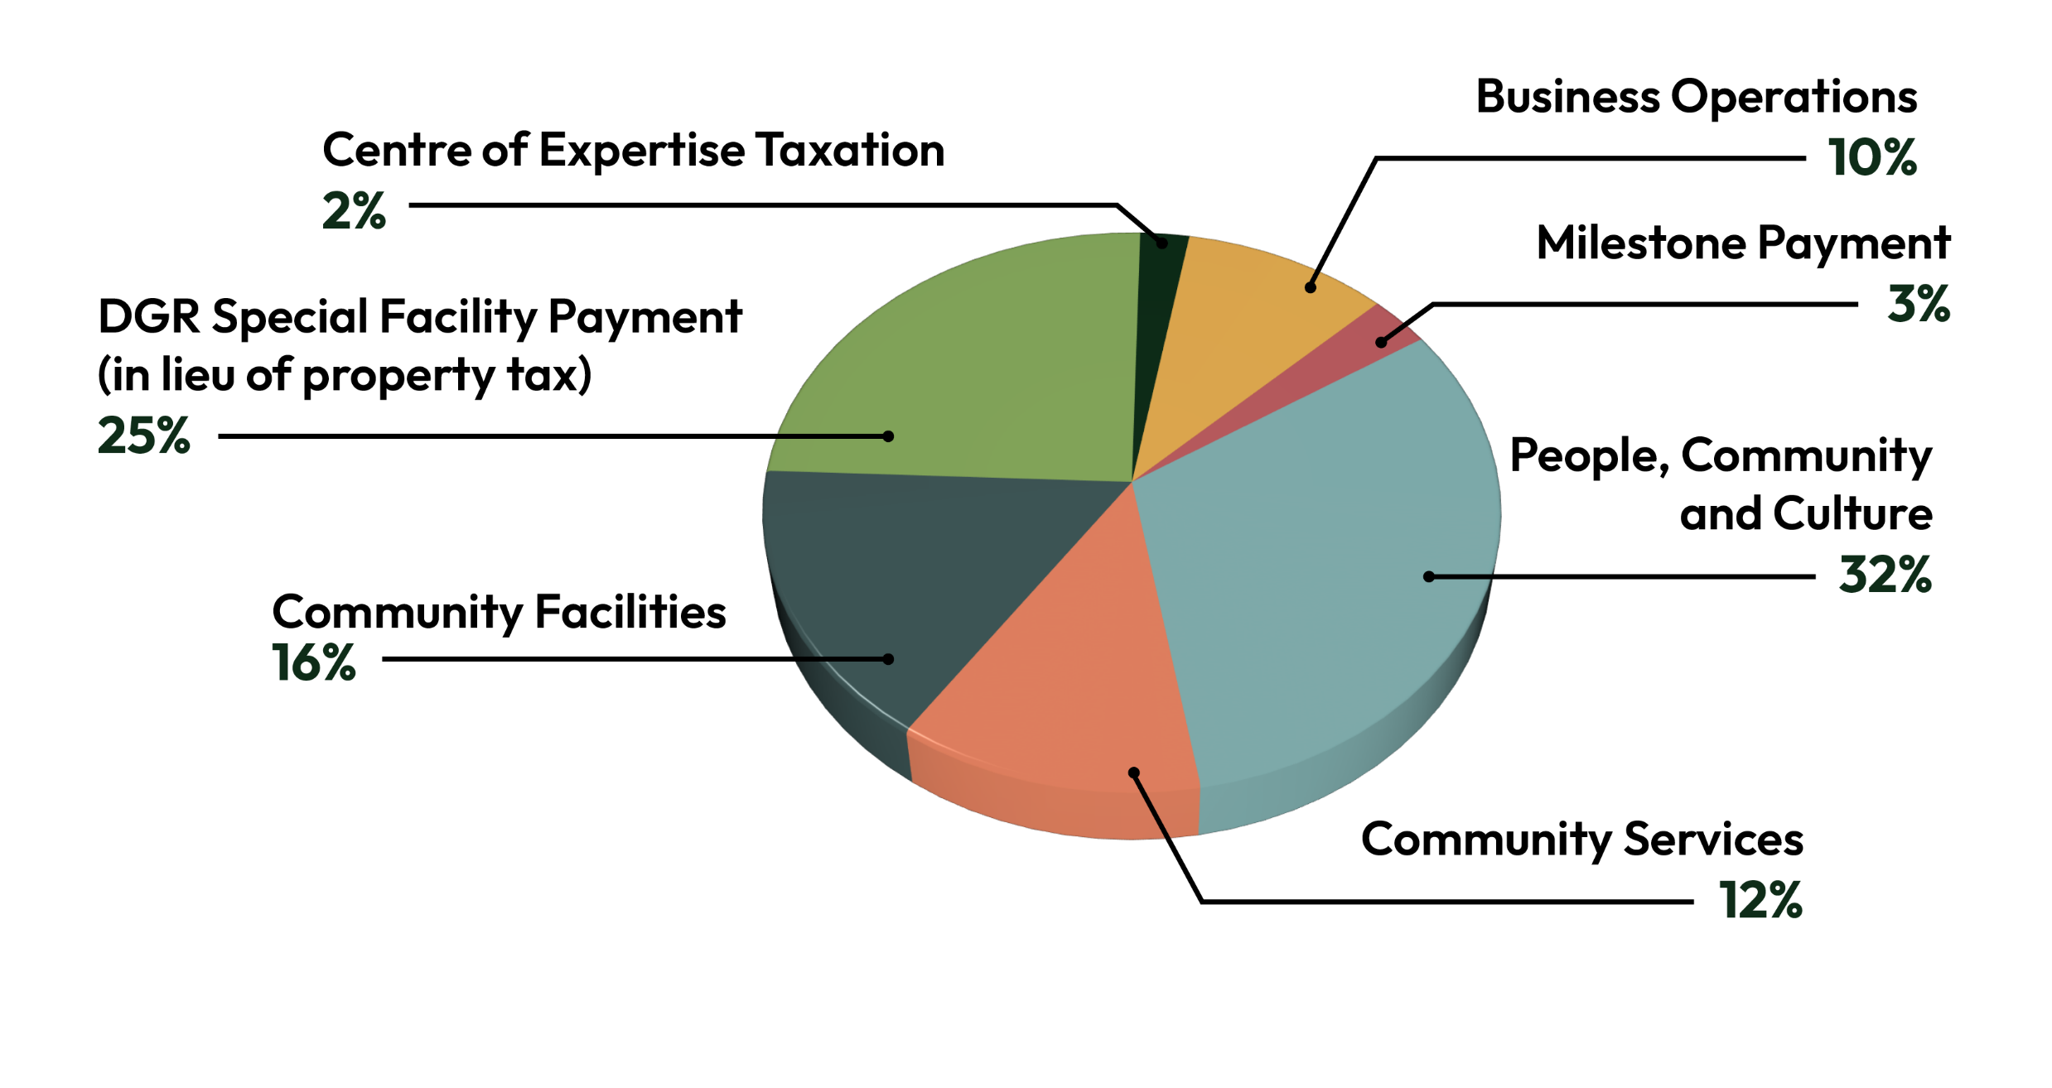
NWMO Funding Categories
Total $418M over 138 years

Slide 10
Funding Timeline
Phase 1
2025 – 2031
$60.6 million
Pre-construction planning/ design
Phase 2
2032 – 2042
$95.2 million
Construction of DGR and surface facilities
Phase 3
2043 – 2092
$209.9 million
Operations
Phase 4
2093 – 2162
$52.5 million
Extended monitoring
Notes:
Generational benefits
Benefits for decades

Slide 11
Thank you!
www.southbruce.ca
www.southbruceswitchboard.ca

