Slide 1
What the Peer Review Experts Say
→ Gregory Ferraro, P. Eng GHD Peer Review Lead
Municipality of South Bruce should continue to work with NWMO on next stages of work – federal Impact Assessment and licensing

Slide 2
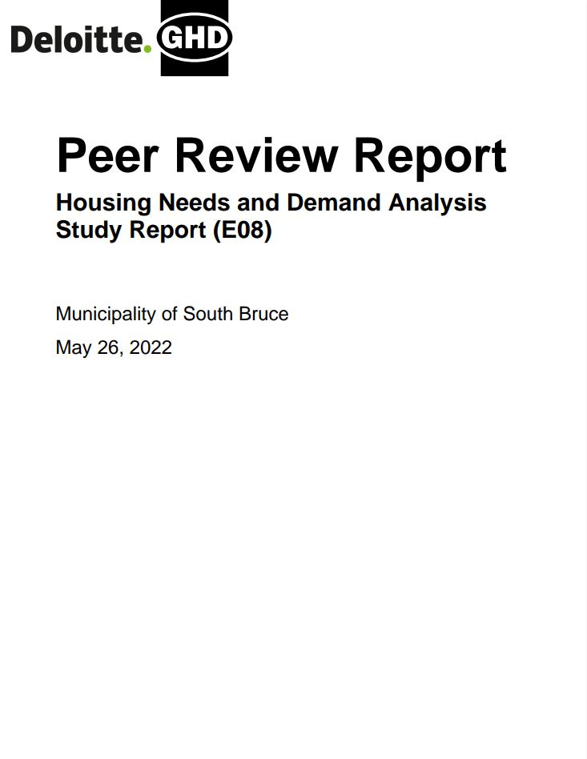
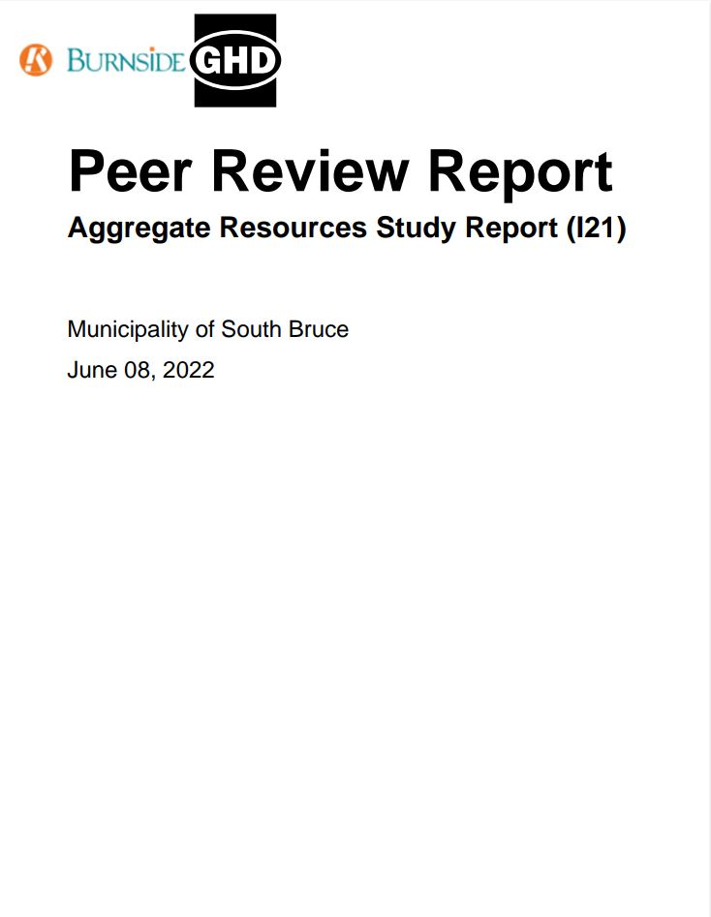
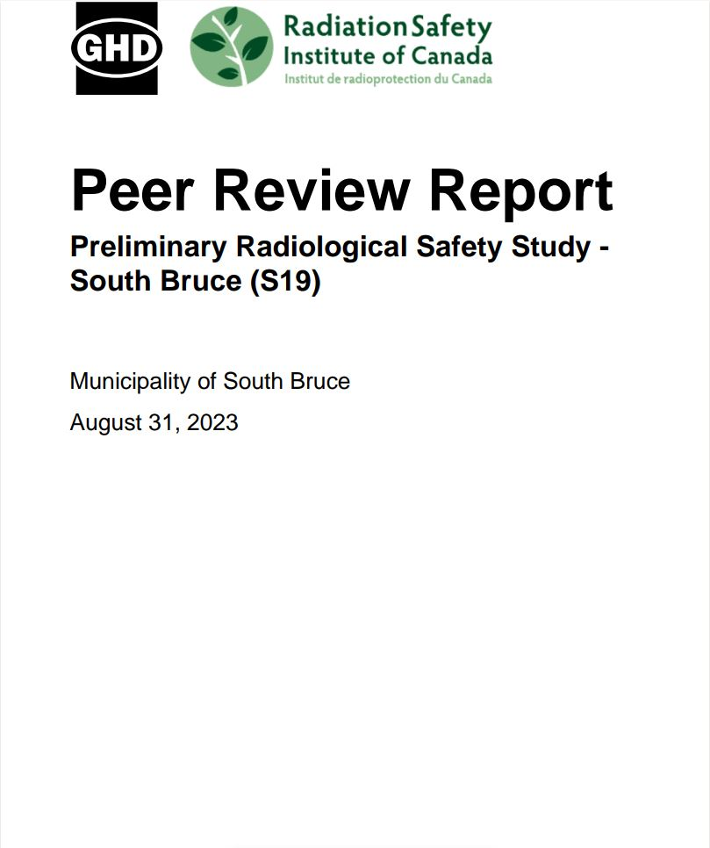
GHD Peer Review Team (PRT)
Independent subject matter experts from professional firms GHD, Deloitte, R.J. Burnside, and Radiation Safety Institute of Canada
Peer review workplans, data, field observations, and study findings produced by the NWMO and Municipality of South Bruce
Produce reports and memos detailing findings (observations, omissions, inconsistencies, questions and recommendations)
The PRT has reviewed so far:
20
32
Socio-economic Studies
Geoscience Reports
36
6
Environmental Reports, Workplans and Field Surveys
Design and Safety Reports

Slide 3
How the PRT Built its Confidence in Safety
The PRT independently:
Reviewed the NWMO’s demonstrated progress toward addressing South Bruce’s Guiding Principles #1, #2, #3 and #7, which respectively require that:
The Project be subject to the highest safety standards.
Sufficient measures be put in place and maintained to ensure the natural environment is protected.
The used nuclear fuel will be transported safely and securely.
Construction management and operation plans detail mitigation measures for potential Project impacts.
The Peer Review focused on:
Community and Socio-economic Impacts
Radiation Safety
Geosphere Characterization
Environmental Baseline Conditions
Impacts and Changes to Biodiversity

Slide 4
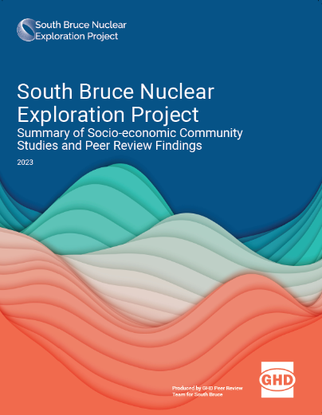
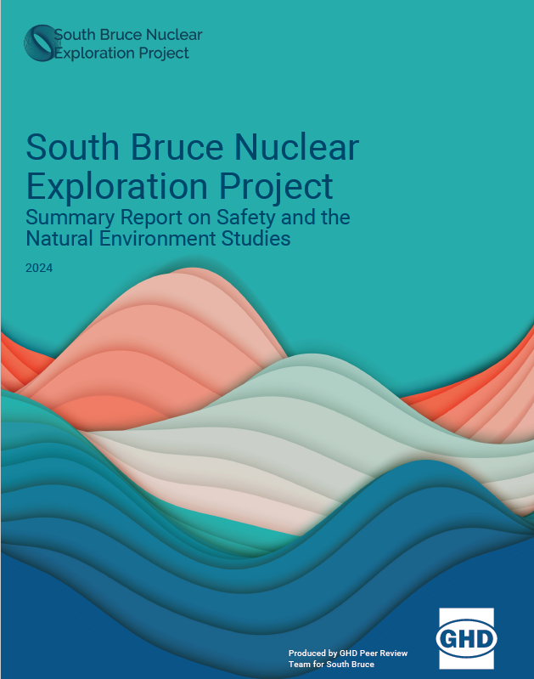
Peer Review Conclusions
The studies show that the identified potential Project effects can be managed with proper planning and resources.
Additional emergency response capacity and capability will be needed locally, which can be addressed through Mutual Aid Agreements and Memorandums of Understanding (MOUs).
The PRT concurs with the radiation safety assessment, with updates required as a site-specific design is developed.
Key to understanding the Project’s environmental impacts is the integration of individual NWMO study findings.
The data collected to date provides progress in demonstrating safety for humans and the environment.

Slide 5
Peer Review Recommendation
There are no significant concerns identified to date that would cause the PRT to advise stopping the process.
The PRT is supportive of South Bruce continuing to work with NWMO on the next stages of work – federal Impact Assessment and licensing.

