Slide 1
Fundamentals of Radioactivity and Radiation Safety

Slide 2
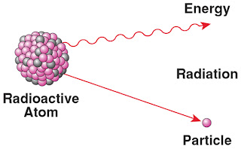
What is Radiation?
Alpha
Beta
Gamma/ X-Ray
Neutrons
Waves or particles that carry energy
Generated by unstable atoms
Atoms want to become stable by releasing extra energy or particles
This is “radioactive decay”

Slide 3
Everyday Radiation Exposure
Ingested Radiation
Cosmic Radiation
Terrestrial Radiation
Medical Radiation
Natural Background Radiation
Canadian Annual Average = 1.8 mSv
Man-Made Sources
Public Annual Dose Limit = 1 mSv
Worker Annual Dose Limit = 50 mSv

Slide 4
Radiation Doses
Fatal Dose
Chest CT
Dental X-Ray
50 Bananas
70,000 Bananas
100,000,000 Bananas (at once)
Mammogram
20,000 Bananas
Daily Background
100 Bananas
Flight from Toronto to Vancouver
400 Bananas
Living Near a Nuclear Plant (1 year)
10 Bananas
Bananas are slightly radioactive due to their potassium content
1 Banana = 0.1 uSv of Dose

Slide 5
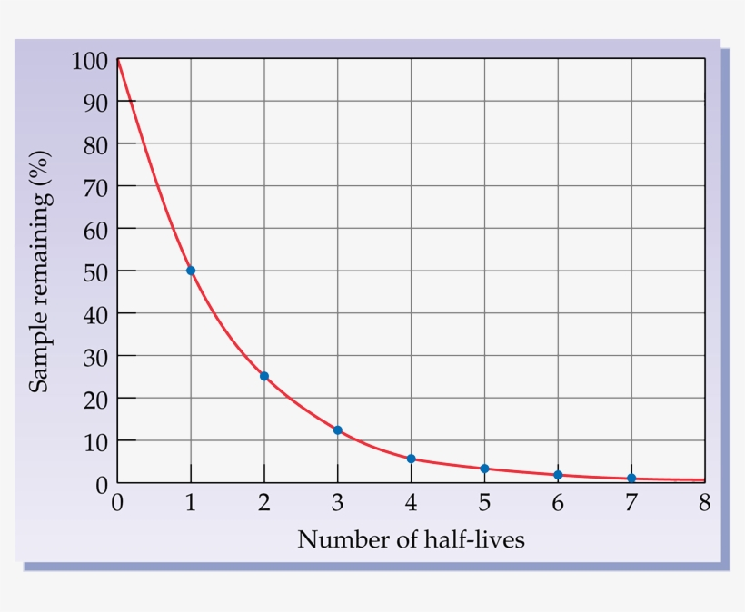
How Does Radioactivity Change Over Time?
Half-life
Fast initial decay then slower
Each type of atom has a unique half-life
Microseconds to Centuries

Slide 6
Radiation Safety
Time
Less time near the radiation source = less total dose
Distance
Further distance from the radiation source = weaker/less radiation
Shielding
Materials between you and the radiation source = less radiation gets through

Slide 7
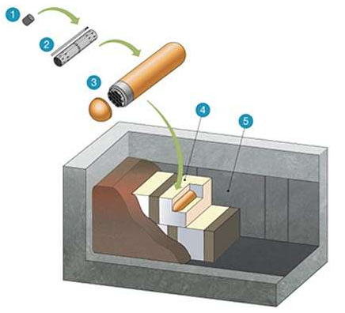
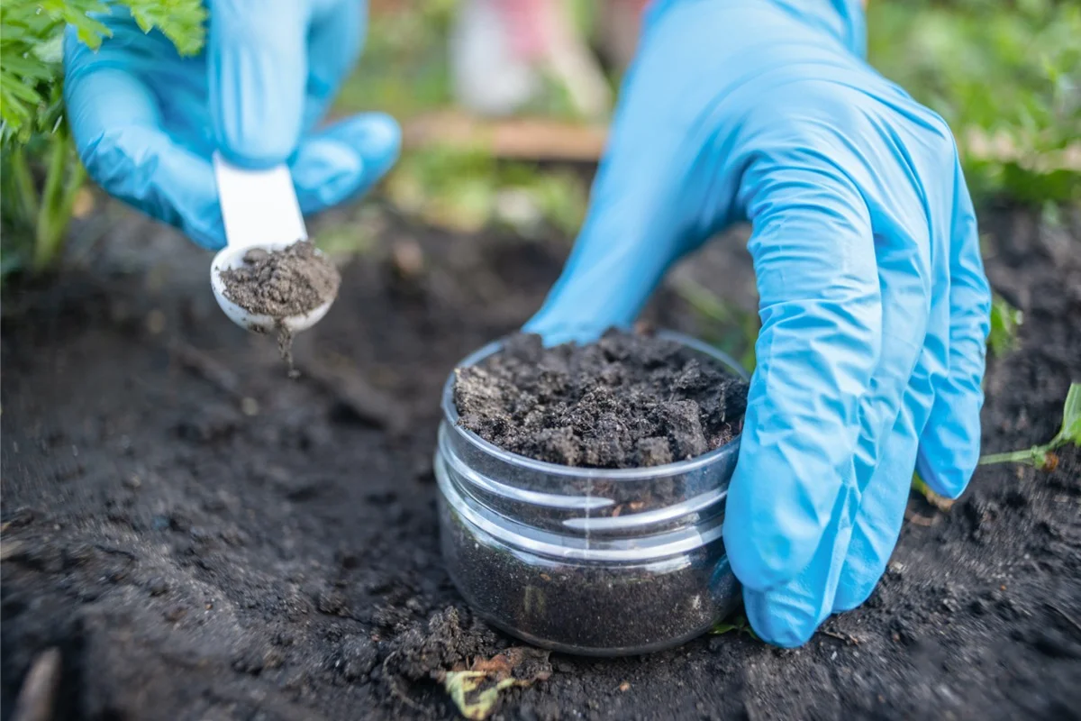
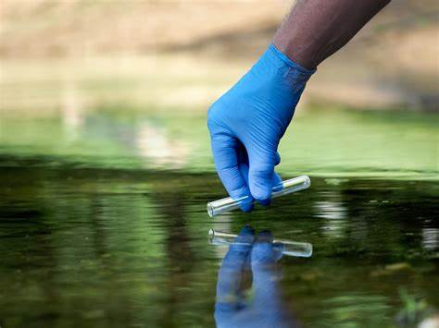
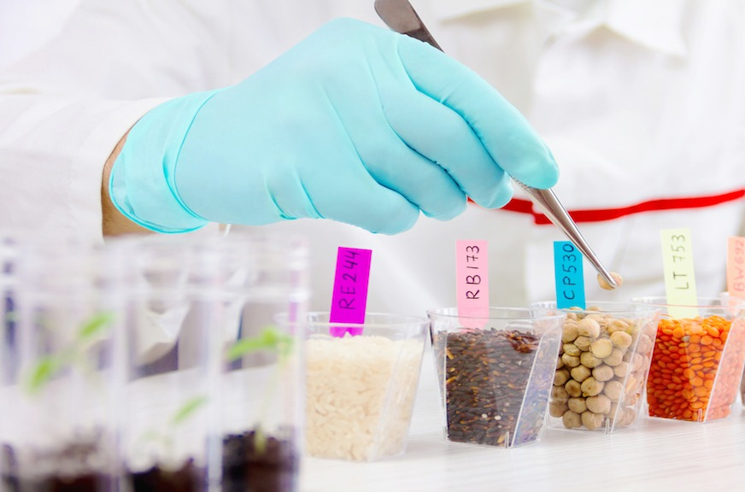
Protecting the Public
Environmental Monitoring
Multi-barrier system
All nuclear facilities (power plants) analyze environmental samples (weekly)
Water, Soil, Air, Food, etc
Confirm and demonstrate the public is protected from radioactive emissions
Radioactive materials are contained in many layers

Slide 8
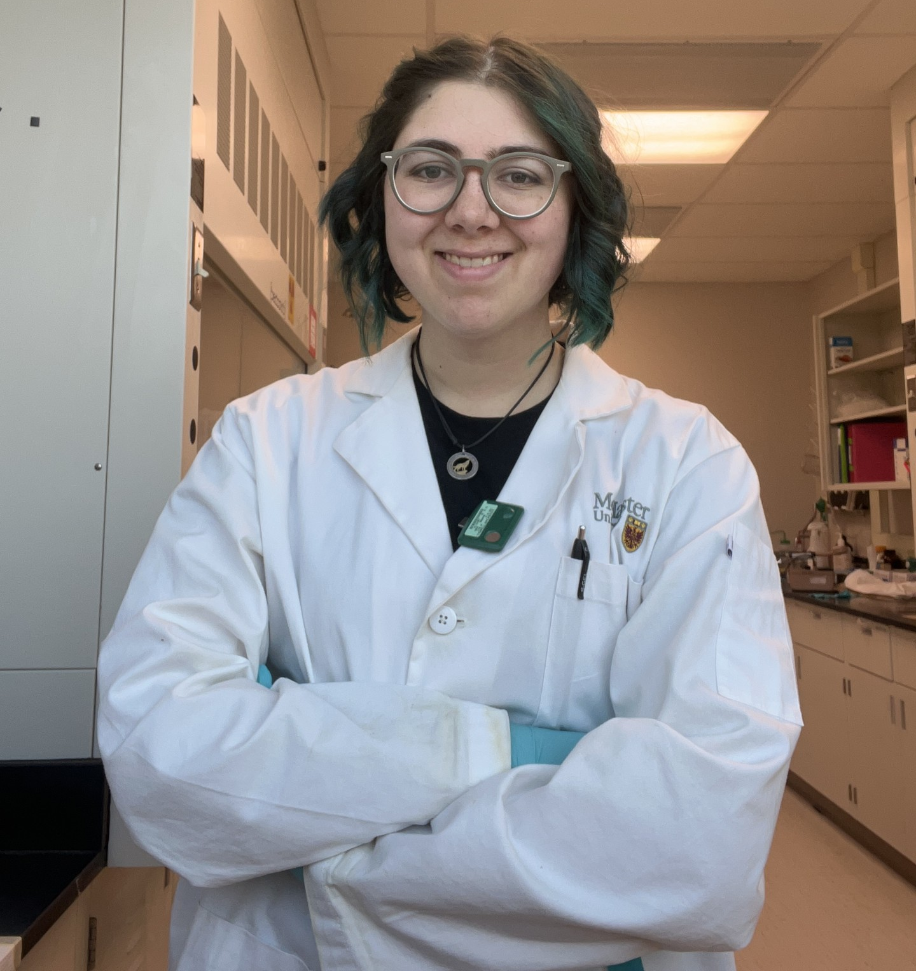
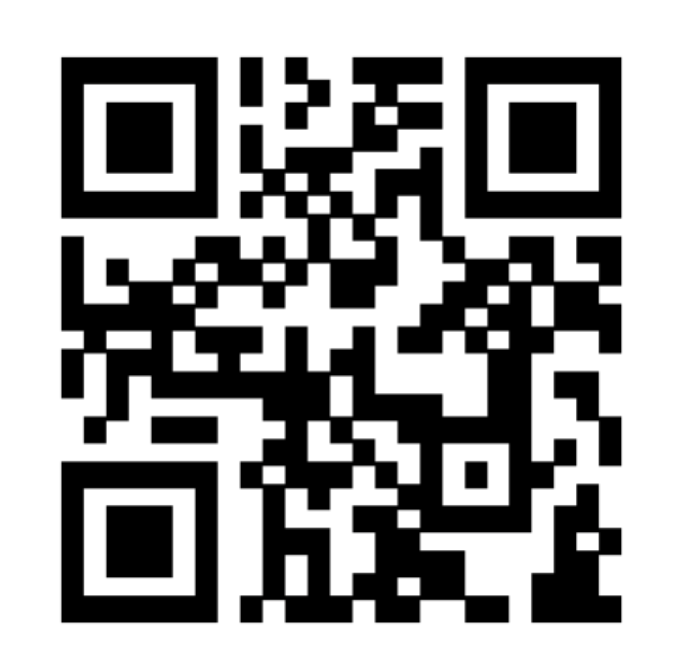
Contact Info
Mackenzie Tigwell
Email
Mackenzie.Tigwell@calian.com
Linkedin
www.linkedin.com/in/mackenzie-tigwell

