Slide 1
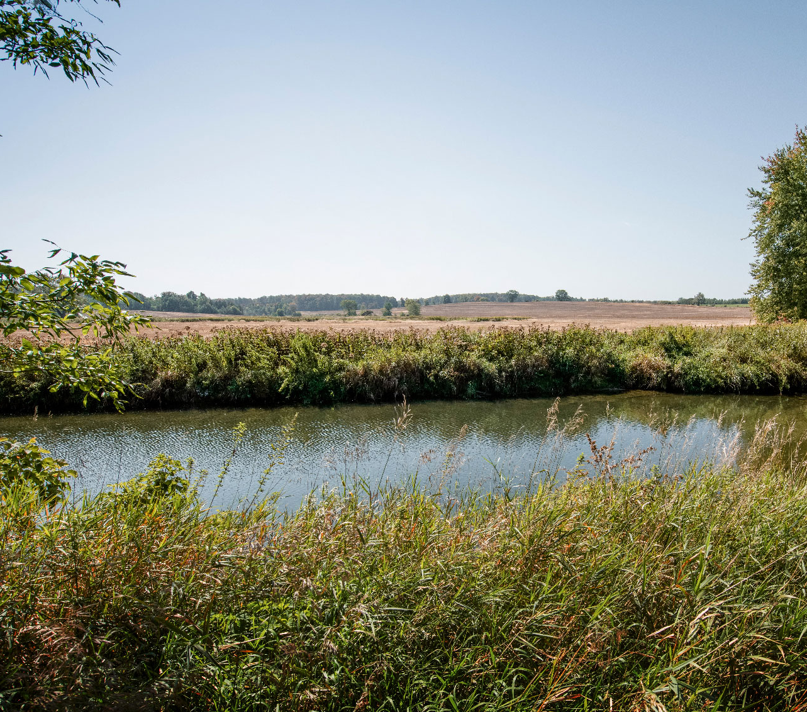
Safety Put Simply
Mark Gobien
Manager, Safety Assessment Integration
South Bruce Nuclear Exploration Forum
May 15th, 2024

Slide 2
Confidence in Safety at South Bruce site
Our confidence in safety is based on a deep geological repository with multiple barriers, an internationally accepted approach.
Plus the evidence of the suitability of the South Bruce site from our recent studies.
Our understanding to date is summarized in our Confidence in Safety Report.
This presentation is a brief summary of key points in the report.

Slide 3
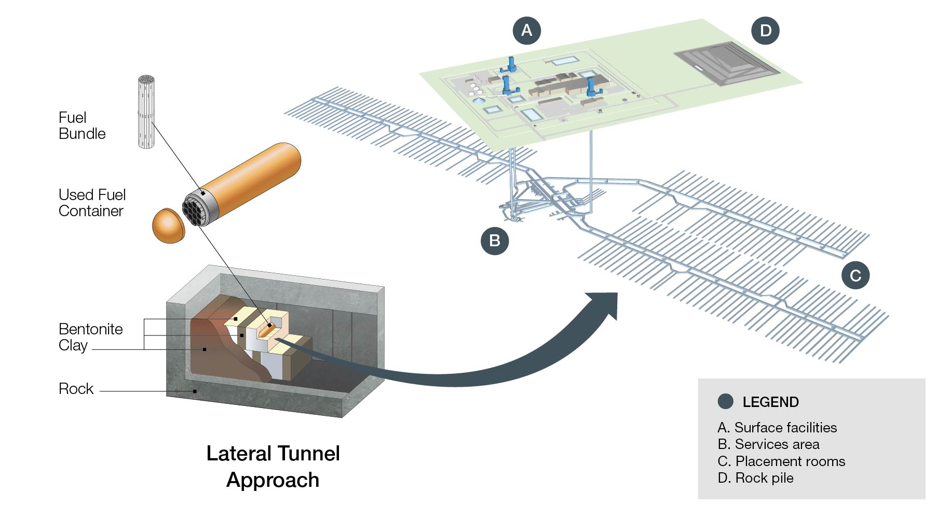
Repository Concept

Slide 4
Repository Location
Niagara escarpment
Cobourg Formation
Proposed DGR location

Slide 5
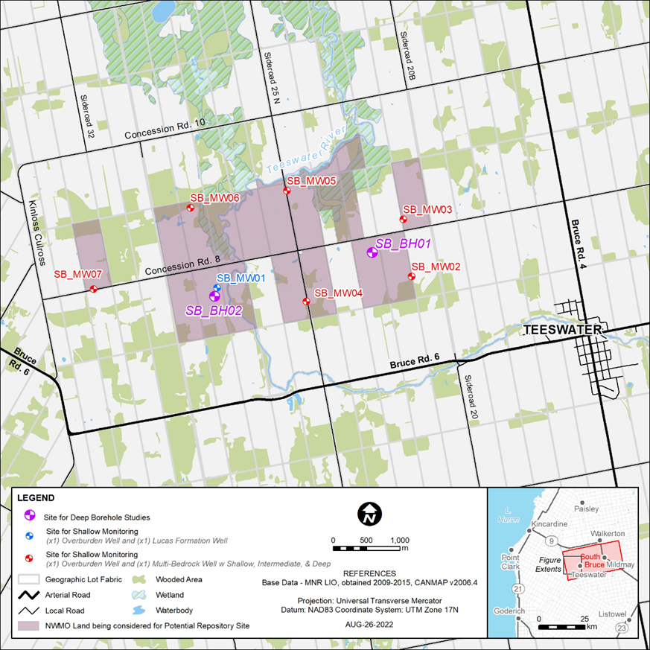
Results of Geology Studies at Site
Boreholes and other tests have confirmed site geology is consistent with regional data.
No active geological features identified.
Deep stable zone observed at site.
Seismically stable.
No natural resources.
Notes:
CIS#1: Favourable geological setting
CIS#2: Stability of geological setting
CIS#3: Low risk of future human intrusion into the repository
CIS#4: Site is amenable to geological characterization

Slide 6
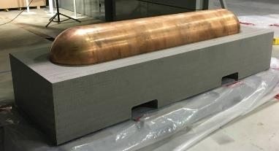
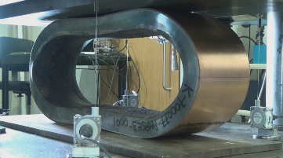
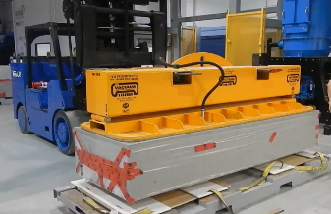
Engineering Design and Proof Testing
Confirmed that surface facility layout can fit within available NWMO land.
Container fabrication and testing completed.
Emplacement trials of engineered barrier system conducted.
More detailed design of surface facilities and underground design is in progress.
Notes:
CIS #5: The robustness of the multiple barrier system
CIS #6: Increase confidence in our ability to safety construct the repository

Slide 7
Safety Assessment
Pre-closure safety considers:
Site preparation, construction, operation, monitoring and decommissioning phases of the DGR project (at least 150 years total).
Operations phase (starting in the 2040s) is when the DGR will be receiving, repackaging and transferring fuel underground.
Post-closure safety considers:
Long-term safety after decommissioning and closure of the repository.
Safety assessment looks at expected performance of the DGR as well as a variety of possible scenarios (including accident conditions) and estimates potential dose consequences to humans.
In all cases, analyses show dose limits are met by large margins.
Notes:
CIS#8: Facility performance will meet regulatory criteria

Slide 8
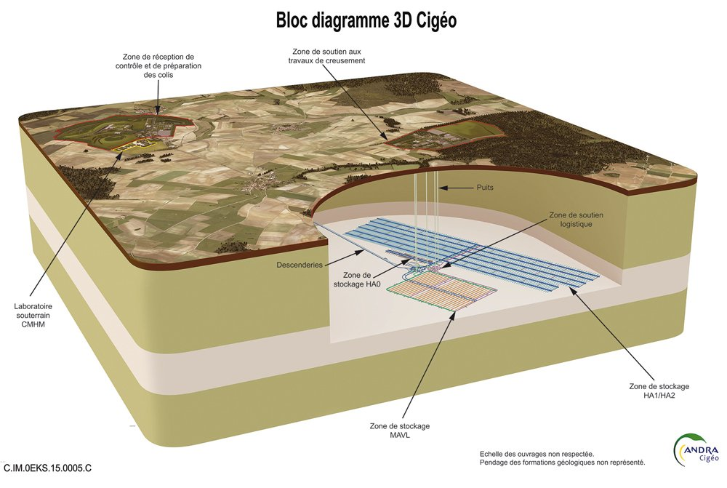
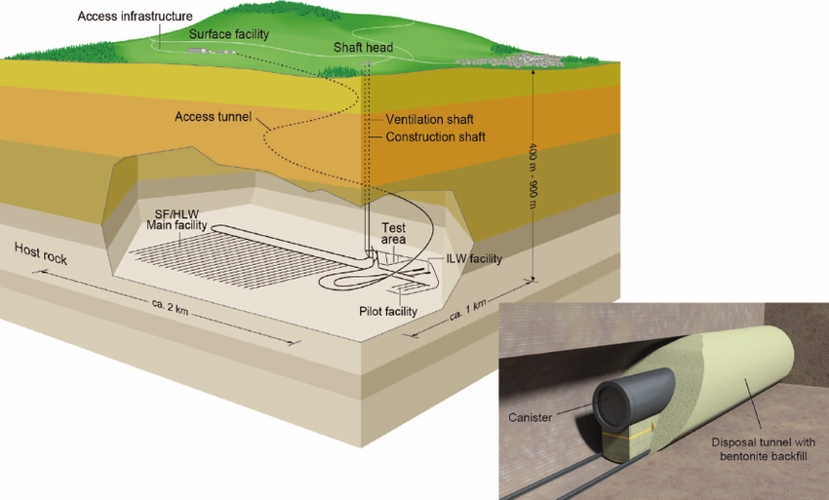
South Bruce rock setting is similar to those being assessed in other countries for a used fuel / high-level waste repository, notably France and Switzerland.
International Experience
Proposed French facility
Swiss facility concept
Notes:
The NWMO is closely following developments in other countries. Both Sweden and Finland have selected repository sites in crystalline rock. Finland is completing their initial repository construction, and NWMO will be observing the early facility commissioning. This will help us improve our design basis.
France and Switzerland have both identified repository sites in layered sedimentary rocks, roughly analogous to the South Bruce site. The NWMO co-operates with all these countries, to learn from their plans and experiences.

Slide 9
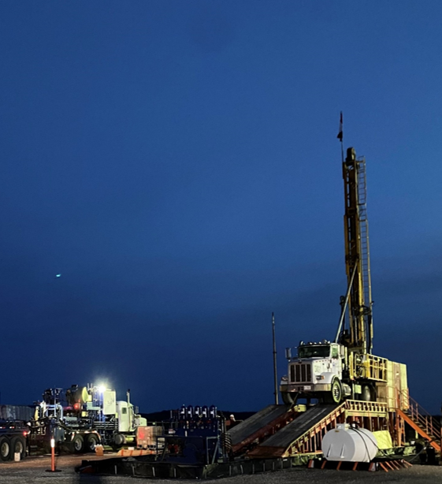
Conclusions and Next Steps
Overall, based on the assessment results to date, the NWMO is confident that a deep geological repository could be safely constructed at the South Bruce Site.
Detailed site characterization is planned should the site be selected to further enhance our understanding of the site.
Following site selection, the NWMO is planning to submit an environmental Impact Statement and a Licence to Prepare Site application

Slide 10
Thank you.

